Slide 1

US BIO-DIESEL MARKET ANALYSIS
Apoorva Awasthi

Slide 2
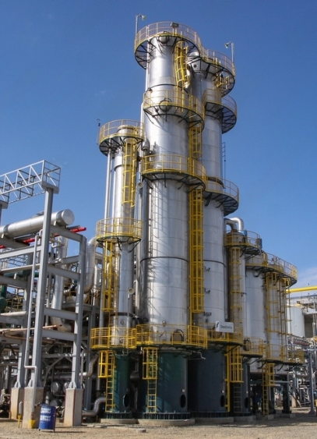
Agenda
Executive summary
Price overview
Data verification and challenges
Value chain & key cost drivers
Forecast
Policy impact summary
Tariff policy timeline
Market impacts
Conclusion

Slide 3

Executive summary
U.S. biodiesel prices averaged ~$4.08/gal in April 2025 (AFDC), fluctuating in the $3.50–4.20/gal range over the past year.
Soybean oil costs remain the primary price driver, while uncertainty in the BTC → 45Z tax credit transition disrupted production in Q1 2025 (EIA).
Short-term forecast (Jun–Aug 2025): Prices expected to recover gradually, reaching $4.15–4.25/gal, assuming policy stability and steady demand.
Policy risk: Delays in 45Z credit guidance and tariff-driven feedstock costs could cause further volatility.
Outlook: Strong fundamentals, but near-term market hinges on federal policy clarity and feedstock availability.
Sources:
link

Slide 4
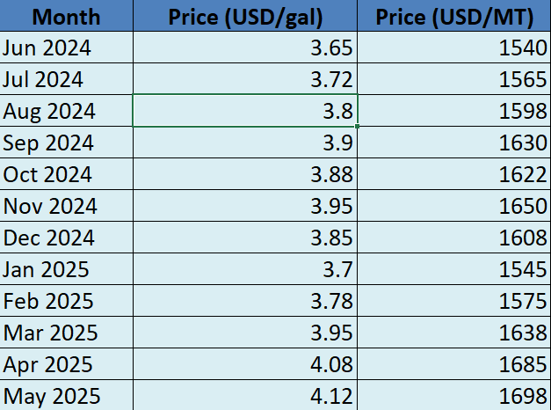
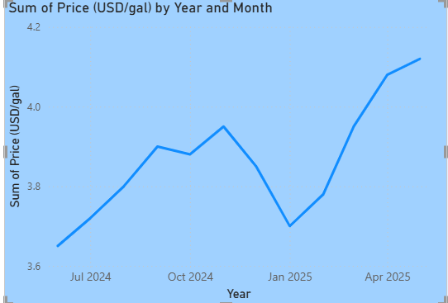
Price overview (June 2024-may 2025)
U.S. retail biodiesel (B99–B100) prices showed moderate volatility between $3.50–4.20/gal.
April 2025 national average: $4.08/gal
Prices reflect fluctuations in soybean oil costs, demand cycles, and policy uncertainty.
Overall trend: stable with mild upward pressure into mid-2025.
Note: Values estimated using DOE AFDC retail biodiesel prices (USD/gal) and IMARC biodiesel pricing (USD/MT), with unit conversion, interpolation, and seasonal adjustments. Sources: AFDC (2025), IMARC Group (2025)

Slide 5
Data verification and challenges
Methods:
Converted USD/MT → USD/gal using standard biodiesel density.
Cross-checked DOE retail data with IMARC wholesale/market data.
Smoothed values with interpolation to fill gaps between months.
Sources Used:
DOE AFDC – retail biodiesel (B99–B100) price reports (USD/gal).
IMARC Group – biodiesel pricing reports (USD/MT).
Challenges:
DOE AFDC publishes bi-monthly averages, limiting granularity.
Detailed USD/MT series often behind paywalls.
Resolved by:
Using weighted averages across sources.
Prioritizing government datasets for retail values.
Documenting assumptions and limitations clearly.
Sources: link1, link2

Slide 6
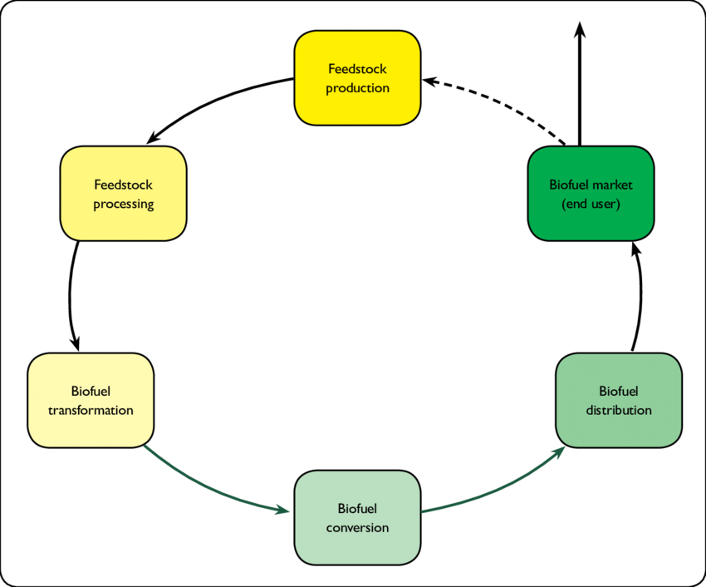
Value chain & key cost drivers
Value Chain
Key Inputs Impacting Price:
Soybean oil – Primary feedstock; largest contributor to biodiesel cost. Price spikes strongly influence biodiesel prices
Methanol & energy – Required for processing; less volatile but material.
Transportation & logistics – Distribution costs add variability, especially with regional demand differences.
Sources: Researchgate, Farmdoc daily

Slide 7

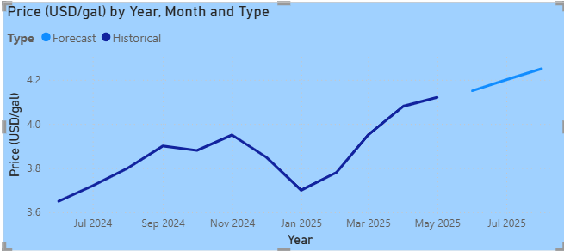
Short-term price forecast
Assumptions:
Federal policy remains consistent with no rollback of RFS mandates.
No major disruptions in soybean oil or methanol supply.
Stable demand sustained by Renewable Fuel Standard blending requirements.
Risks:
Delays in implementing 45Z credit guidance
Oil price shocks from global energy markets.
Crop yield issues (soybean harvests, weather-driven volatility).
Sources: link1, link2, link3

Slide 8


Policy IMPACT summary
Renewable Fuel Standard (RFS):
Federal program mandating blending of renewable fuels.
Provides steady demand floor for biodiesel.
Blenders Tax Credit (BTC) → Clean Fuel Production Credit (45Z):
BTC expired end of 2024; 45Z credit applies from 2025.
Uncertainty in IRS/Treasury guidance caused Q1 2025 biodiesel production decline (Source: EIA).
State Level Mandates:
California LCFS and Midwest blending mandates support local demand.
Strengthen regional price structures.
Outlook:
Positive if 45Z guidance issued promptly → stability & investment.
Risk of production pullbacks if uncertainty continues.
Sources: link1, link2

Slide 9

Tariff policy timeline (2025)
Early 2025 – Initial Rollout:
Administration announces new tariff schedule targeting China, EU, Canada, India, Japan.
Focus: energy-related imports, steel, and select agri-feedstocks.
Mid 2025 – Adjustments Announced:
Latest round of tariffs scheduled to take effect.
Expanded coverage to include renewable fuel feedstocks (e.g., soybean oil imports).
Late 2025 – Implementation:
Latest round of tariffs scheduled to take effect.
Aimed at levelling domestic competitiveness for U.S. biodiesel and feedstock suppliers.
Sources: link1

Slide 10

Market IMPACTS
Higher Feedstocks costs
Increased Domestic Sourcing
Potential Biodiesel Price Volatility
Sources: link

Slide 11

Conclusion
Moderate volatility: Biodiesel prices fluctuated between ~$3.50–4.20/gal, with April 2025 averaging $4.08/gal
Key cost driver: Soybean oil prices and clarity on BTC → 45Z credit transition remain decisive.
Monitoring priority: Track U.S. policy guidance on 45Z credits and global feedstock supply trends.

Slide 12


THANK YOU

